Slide 1

BREAST CANCER DATASET
CLASSIFICATION MODEL

Slide 2

ACKNOWLEDGEMENT
I would like to thanks Mr. Vineet Saxena sir and Ms. Prachi Garg mam for their expert advise and encouragement throughout this Project, as well as Mr. Rahul Garg sir for his supervision.
Notes:
Notes to presenter:
What is your purpose for sharing this reflection?
Is it at the end of a unit or project?
Are you sharing this reflection, at the attainment of a learning goal you set for yourself?
Is it at the end of a course?
State your purpose for the reflection or even the purpose of the learning experience or learning goal. Be clear and be specific in stating your purpose.

Slide 3

INTRODUCTION
Breast cancer is one of the most common cancers among women worldwide, making it a significant public health problem in today’s society
Notes:
Notes to presenter:
Description of what you learned in your own words on one side.
Include information about the topic
Details about the topic will also be helpful here.
Tell the story of your learning experience. Just like a story there should always be a beginning, middle and an end.
On the other side, you can add a graphic that provides evidence of what you learned.
Feel free to use more than one slide to reflect upon your process. It also helps to add some video of your process.

Slide 4
OBJECTIVE
This analysis aims to observe which features are most helpful in predicting malignant or benign cancer and to see general trends that may aid us in model selection .
The goal is to classify whether the breast cancer is benign or malignant.

Slide 5

ABOUT THE DATASET
ATTRIBUTE INFORMATION
REAL-VALUED FEATURES
Diagnosis:
M = malignant,
B = benign
Radius
Texture
Perimeter
Area
Smoothness
Symmetry
Compactness
Concavity
Concave points
Fractal Dimension
Notes:
Notes to presenter:
What was important about this learning experience?
How is it relevant to your course, yourself, or your society or community?
Why is this significant?
This SmartArt allows you add images and text to help outline your process. If a picture is worth a thousand words, then pictures and words should help you communicate this reflection on learning perfectly! You can always click on Insert>SmartArt to change this graphic or select the graphic and click on the Design contextual menu to change the colors.

Slide 6

Process Of Building A Model
FEATURE ENGINEERING
AND
FEATURE SCALING
EXPLORATORY
DATA
ANALYSIS
01
04
02
TRAINING &
TESTING
THE DATA
03
MODEL
SELECTION
Notes:
Notes to presenter:
What did you think at first?
What obstacles did you encounter along the way?
How did you overcome those obstacles?
What images can you add to support your process?
This SmartArt allows you add images and text to help outline your process. If a picture is worth a thousand words, then pictures and words should help you communicate this reflection on learning perfectly! You can always click on Insert>SmartArt to change this graphic or select the graphic and click on the Design contextual menu to change the colors.
Feel free to use more than one slide to reflect upon your process. It also helps to add some video of your process.

Slide 7
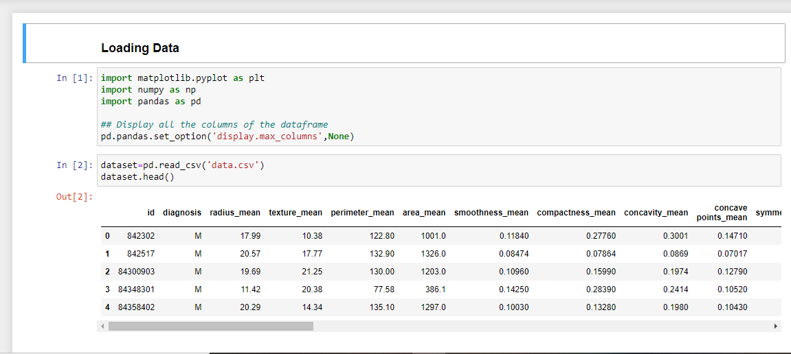
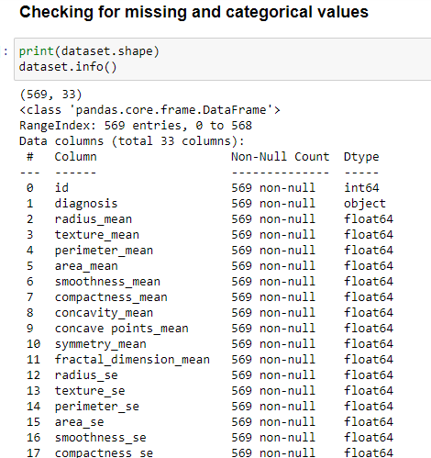
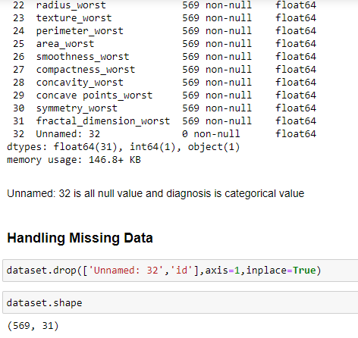
Loading and Handling the data

Slide 8
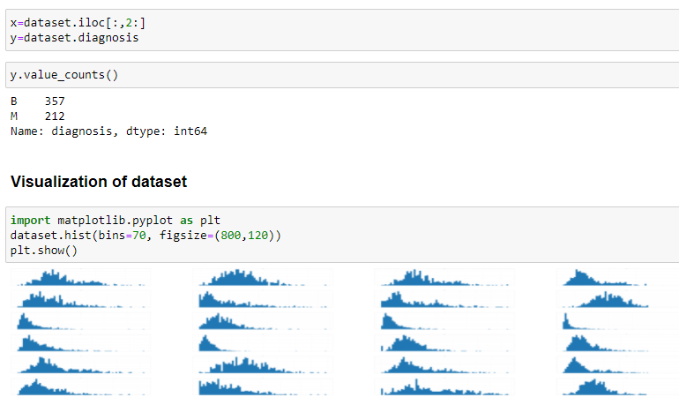
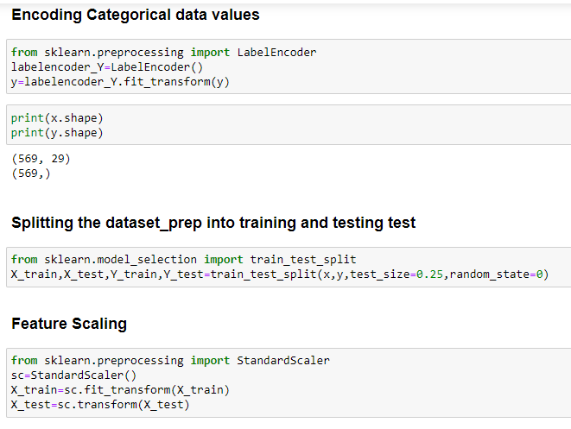
Preparing the Data

Slide 9
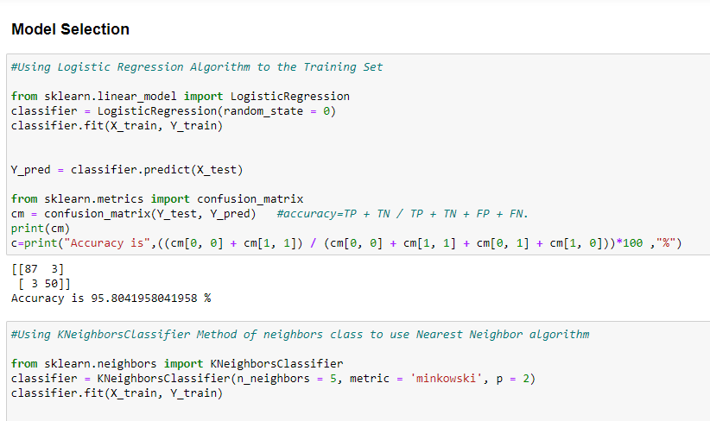
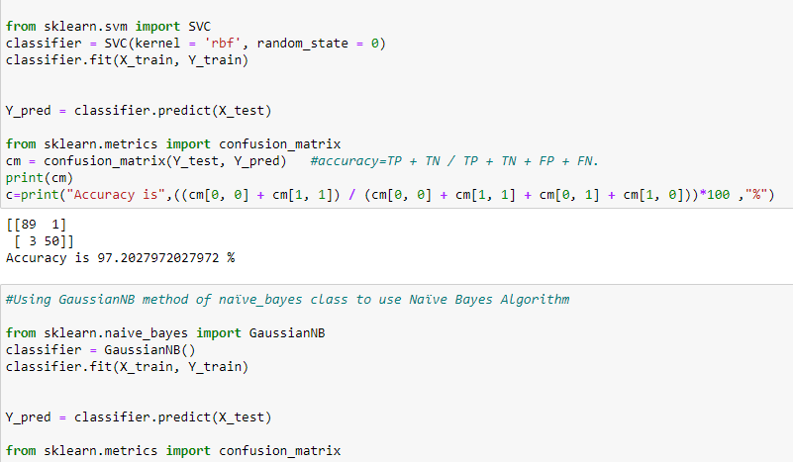
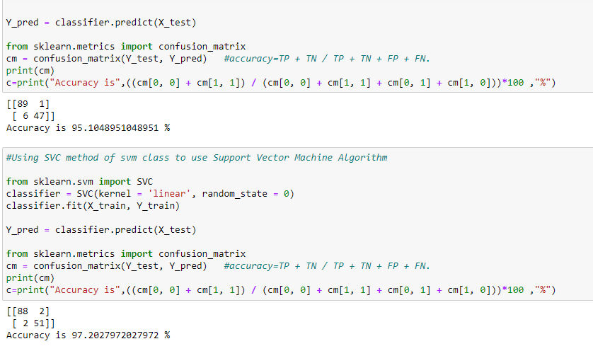
Model selection
Trying various models for better accuracy.

Slide 10
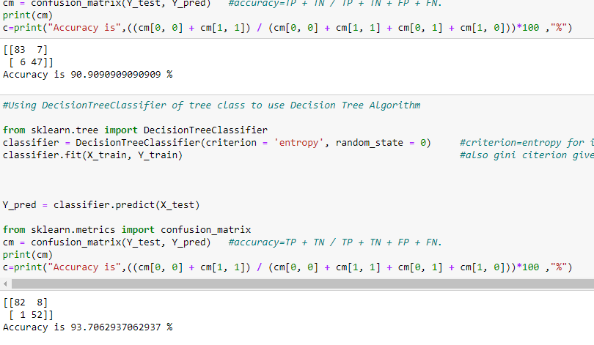
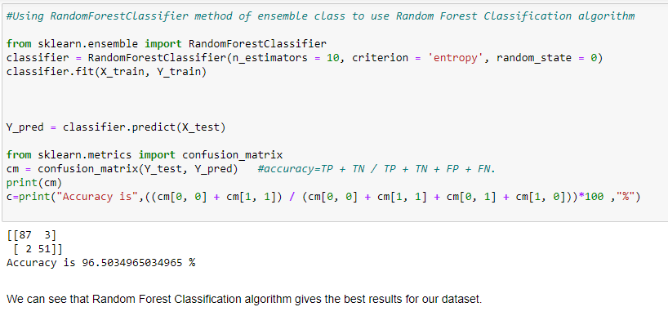
CONCLUSION:
As we can see from the attached images, Random Forest Classification algorithm gives the best results about 96.50% for our dataset.

Slide 11
THANK YOU.

